Slide 1
Shortcuts from an Impatient DBA
Andy Mallon

Slide 2

Andy Mallon
Product Manager at SentryOne
Working with SQL Server since 2003 (SQL Server 2000)
Background in Tech Support, Database Administration, and Database Architecture
Lazy
Impatient

Slide 3








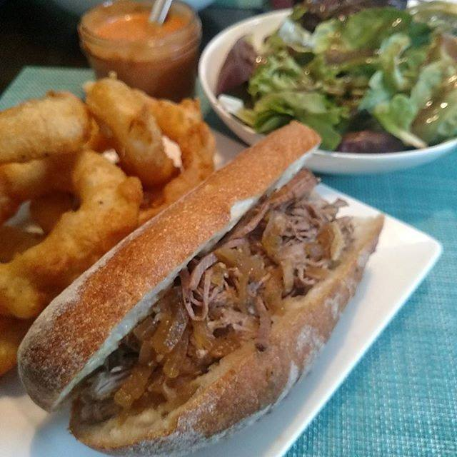


Notes:
What I spend my time doing – Both work…..and at home

Slide 4
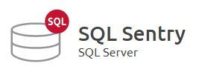

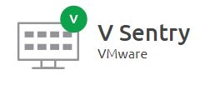
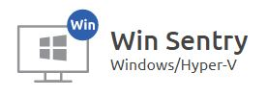
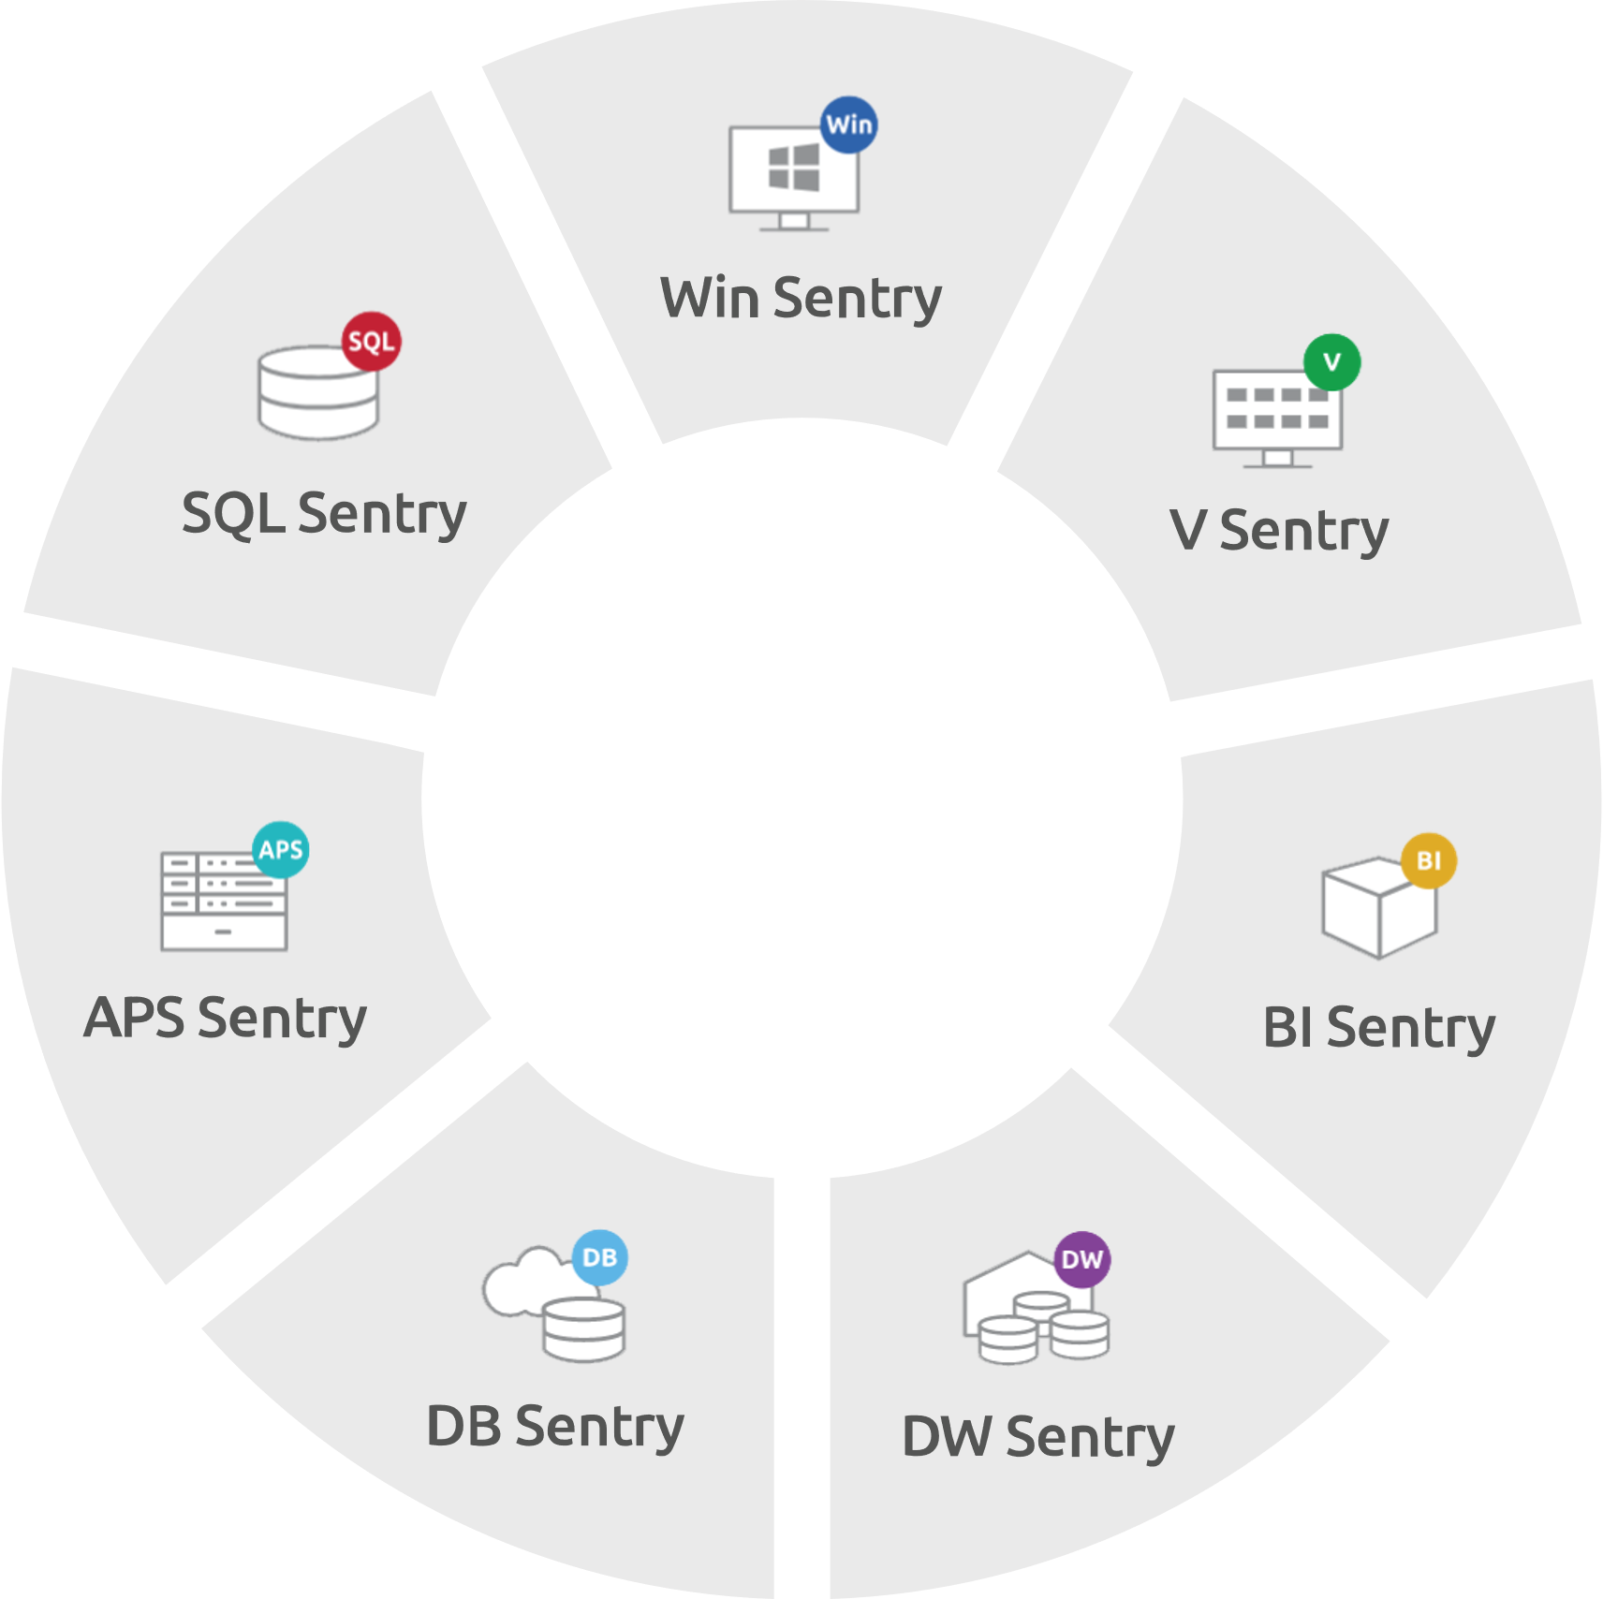
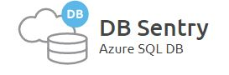
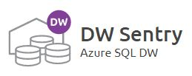
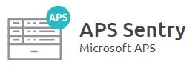


S1 Provides End-to-End Visibility Across the Data Platform
Monitor, diagnose, and optimize SQL Server performance.
Find and fix SQL Server Analysis Services (SSAS) performance problems
Monitor resource utilization (memory, CPU, network, storage) of virtualized environment.
Boost Windows Server and Hyper-V virtualized environment performance.
Keep Azure SQL Databases running at peak efficiency with performance metrics including DTU usage.
Accelerate Azure SQL Data Warehouse performance with visibility into workload impacts.
See performance information for Microsoft Analytics Platform system, including data movement and details about distributed queries.

Slide 5








Notes:
https://www.sentryone.com/sentryone-acquires-pragmatic-works-software

Slide 6


Contact Andy
Andy@AMtwo.co
@AMtwo
am2.co/shortcuts
andy@am2.co

Slide 7

Who uses Twitter?
Where the SQL Community hangs out
#sqlhelp
Free real-time help
Notes:
Who doesn’t want free advice from Brent Ozar or Aaron Bertrand?

Slide 8

Who uses Slack?
If nvarchar(140) isn’t enough
#sqlhelp #powershellhelp #dbafundamentals
http://SQLslack.com for details
Notes:
Who doesn’t want free advice from Brent Ozar or Aaron Bertrand?

Slide 9

Session Feedback
Tell me what you don’t like
Tell me what can be better
Tell me what you like

Slide 10

I'm also gonna need you to go ahead and silence your mobile phones
Yea…….You apparently didn’t put one of the new coversheets on your TPS reports.

Slide 11
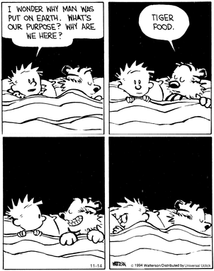
Why are we here?
This is a performance tuning session
We’re just tuning the other side of the keyboard
©1994 Bill Watterson

Slide 12
Agenda
SSMS Keyboard shortcuts
Other SSMS shortcuts & tricks
Windows Keyboard shortcuts
Other Windows shortcuts & tricks
Everyone should learn at least one thing!
Notes:
DBAs and Developers use Windows, too. We’re not going to pigeonhole ourselves by just looking at database stuff

Slide 13
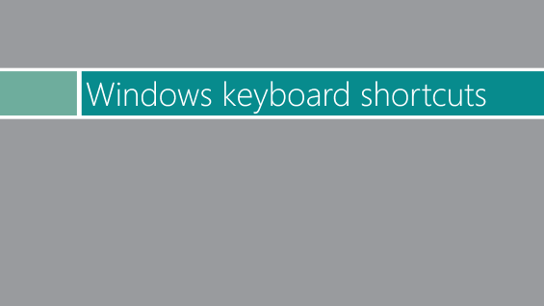

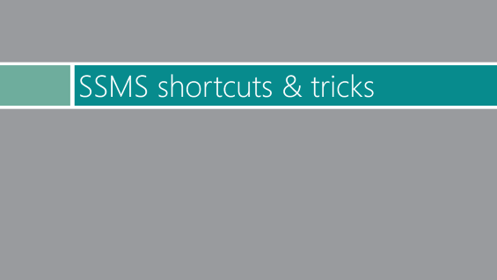
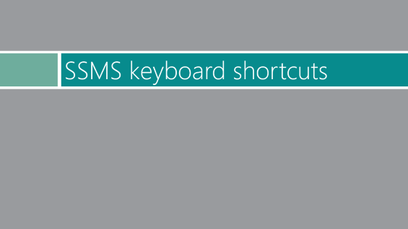

Slide 14
SSMS keyboard shortcuts

Slide 15
SSMS Keyboard shortcuts
(the ones you might already know)
Ctrl + (Shift +) Tab
Ctrl + R
Ctrl + L
Ctrl + M
Ctrl + (K,U) / Ctrl + (K,C)
Shift + Alt + Enter
Ctrl + U
Switch Tabs
Show/ hide Results pane
Get estimated execution plan
Include actual execution plan
Un/Comment selected text
Toggle full screen
Database-selection dropdown
Up, Up, Down, Down, Left, Right, Left, Right, B, A, Start
Notes:
POP QUIZ… One at a time, who knows what these do?

Slide 16

30 free lives
Notes:
Sorry, that one isn’t SSMS, its NES

Slide 17
More SSMS Keyboard shortcuts
(the ones you might not know)

Slide 18
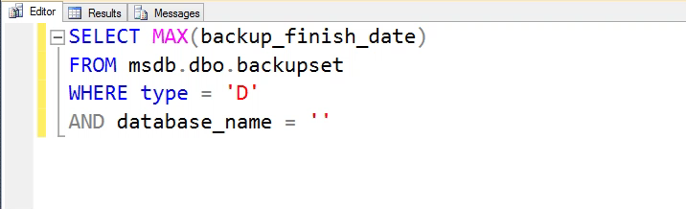
CTRL + SHIFT + V
Clipboard ring
Pasting the less-than-most-recent thing
Never lose something that only existed on your clipboard
Last 15 clipboard entries

Slide 19
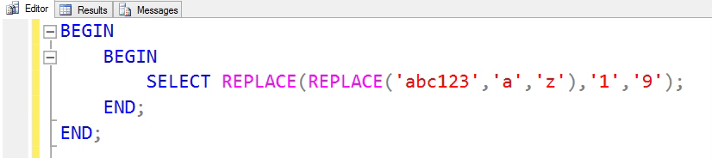
CTRL + ]
Go to BEGIN/END
Put cursor next to a BEGIN, then Ctrl + ] to bring you to corresponding END
Also works with parentheses, etc

Slide 20
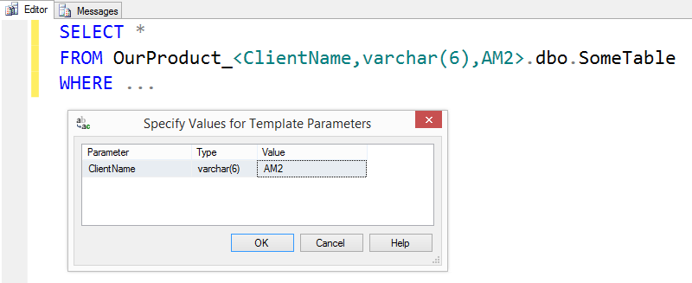
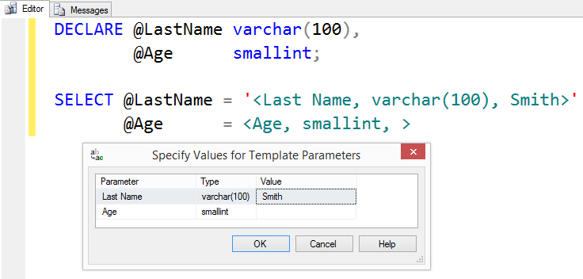
CTRL + SHIFT + M
Template Replacement
Using templates for saved/reusable scripts
<label, datatype, default value>
Notes:
Notice how the stuff in the quotes isn’t red!!
Especially great for multi-tenant hosting environment

Slide 21
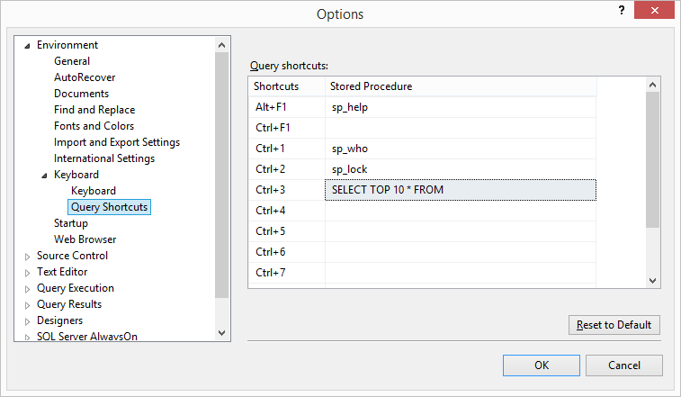
SSMS Query Shortcuts
3 Built-in, non-customizable
9 customizable shortcuts
Get to frequent queries quickly
Highlight text, then use shortcut key combination
SELECT TOP 10 * FROM
Highlight table name, hit Ctrl+3

Slide 22
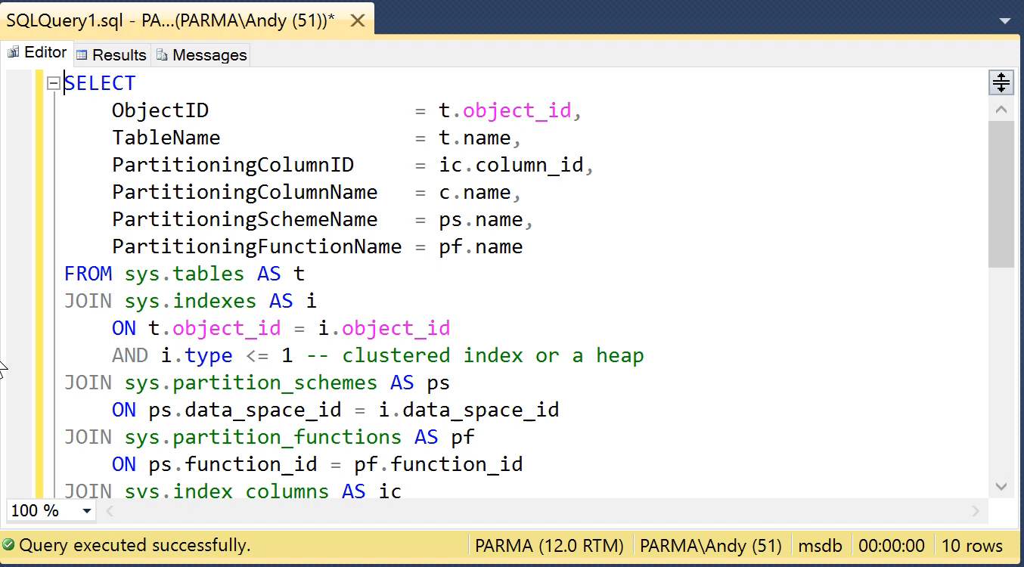
SSMS Query Shortcuts
3 Built-in, non-customizable
9 customizable shortcuts
Get to frequent queries quickly
Highlight text, then use shortcut key combination
SELECT TOP 10 * FROM
Highlight table name, hit Ctrl+3

Slide 23
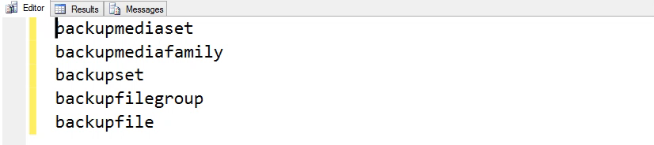
ALT + SHIFT + Arrow ALT + DRAG
Block highlighting / vertical highlighting
Easily edit a column of text

Slide 24
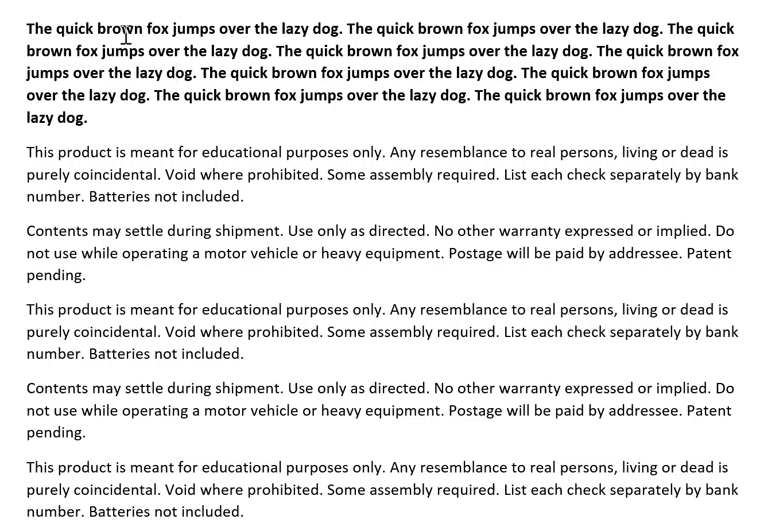
ALT + SHIFT + Arrow …In Microsoft Word

Slide 25
SSMS shortcuts & tricks

Slide 26
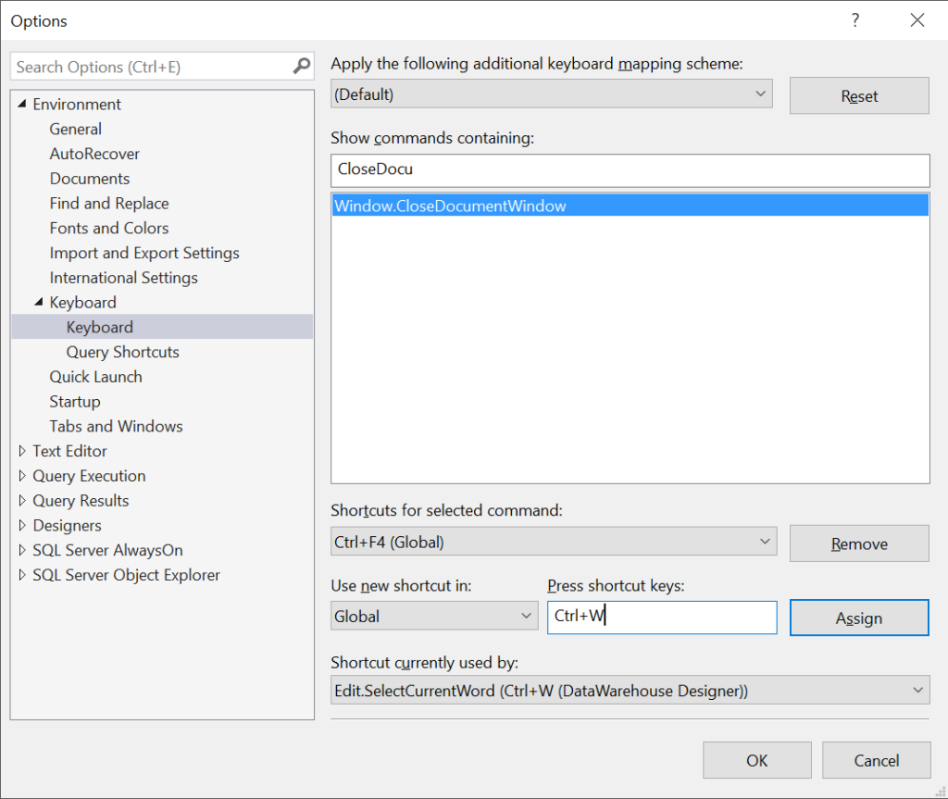
Remapping SSMS Shortcuts
You can customize keyboard shortcuts, for virtually every action in SSMS
am2.co/RemapSSMS

Slide 27
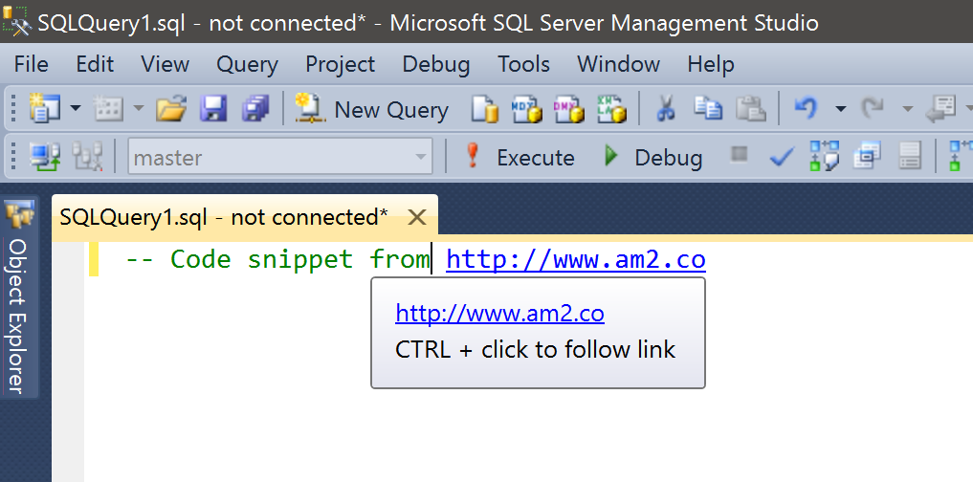
SSMS has a web browser built-in
URLs in your comments are clickable
Notes:
Works great for attribution of code that you grabbed from the interwebz
Also great for pointing at a wiki or internal documentation

Slide 28

Management Studio Drag
Drag-drop a tab in SSMS to re-order
Drag a tab out of SSMS to float/undock
Also Window→Float from the menu
Chrome, IE/Edge, and other apps with tabbed UIs offer similar behavior
Bianca del Rio Image from Lujon Magazine http://go.am2.co/1XKDbNR
Notes:
One difference between Chrome & SSMS is that dragging a tab OUT will create another full window of Chrome, complete with menu bars, etc. In SSMS, your tab literally floats outside the existing SSMS. Both your “main” SSMS and your floating tab are in focus at the same time

Slide 29
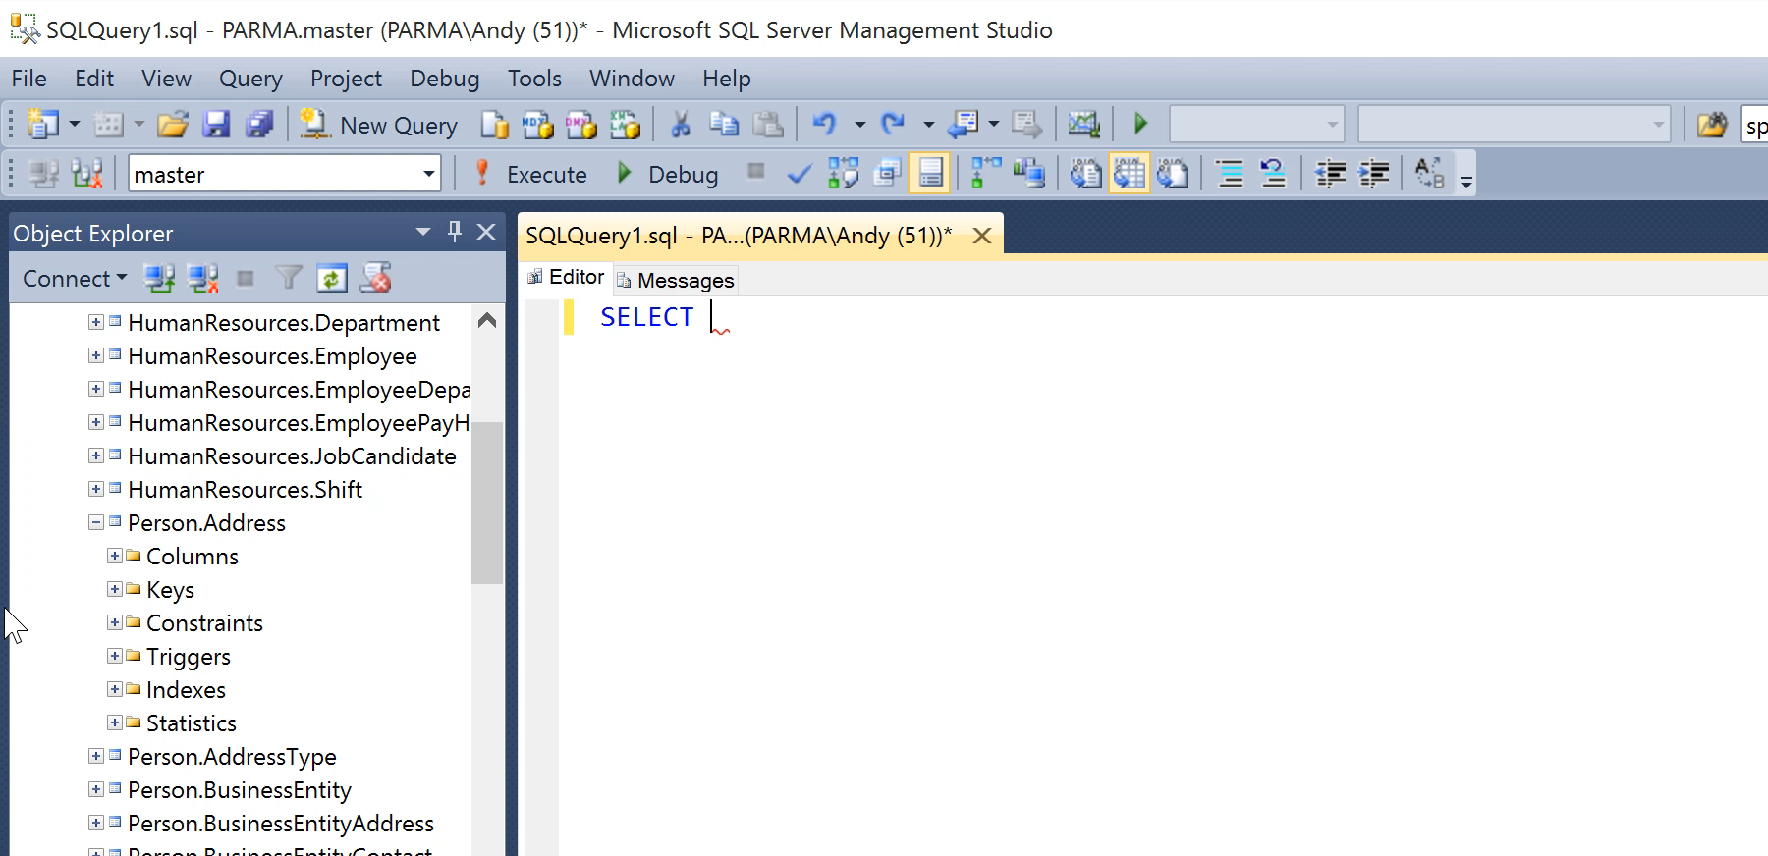
All the columns
Drag “Columns” folder from Object Explorer to list all column names
This doesn’t work with every folder in Object Explorer

Slide 30
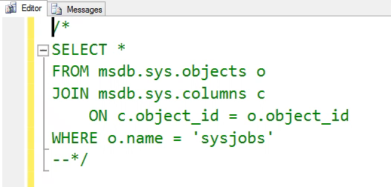
Comment out your comments
More easily comment/uncomment long comments
Use /* to start the comment, and --*/ to end
Comment out the start, and you un-comment the whole thing
No need to hunt for where the comment ends

Slide 31
Wild about wildcards
SELECT stuff FROM my.table WHERE stuff LIKE 'Thi%'
SELECT stuff FROM my.table WHERE stuff LIKE 'Thi_'
Multi-character wildcard
Single-character wildcard
stuff
This
This is a multi-character wildcard.
This is boring. I know this.
stuff
This

Slide 32
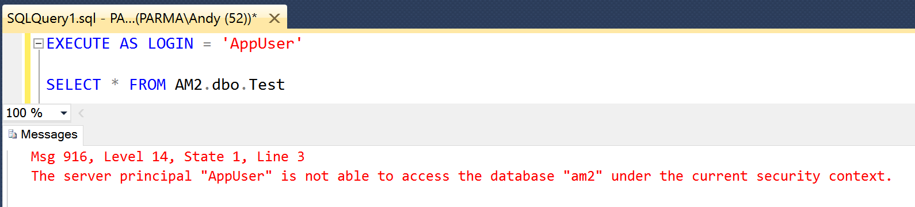
Execute code as a different user
EXECUTE AS LOGIN = 'LoginName'
Requires IMPERSONATE permission
GRANT IMPERSONATE ON LOGIN::[LoginName] TO [Impersonator]
Remember to REVERT
Notes:
This is HUGE for DBAs who are debugging permissions issues.

Slide 33
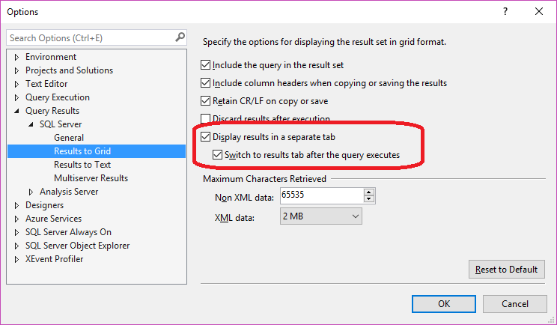
Results as separate tab
Results as separate tab, instead of results pane
F6 to switch between tabs
Ctrl+R to hide the results pane won’t work, because there’s no results pane
Good for when screen real estate matters
Laptop screen
Projector
Long queries
Notes:
You’ll see most presenters using this, but I love it anytime I’m working on my teeny tiny 13” laptop screen.
NOTE: This won’t affect tabs already open. You’ll need to open a new tab.

Slide 34
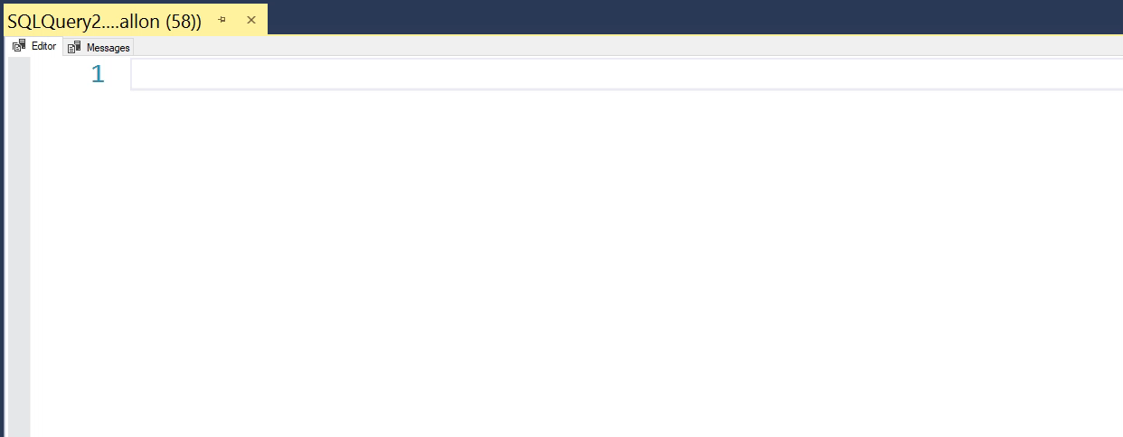
Results as separate tab

Slide 35
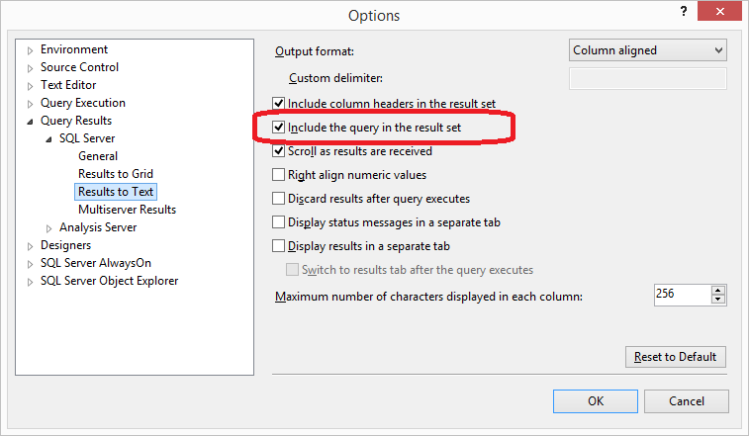
Include query in result set
Makes a quick report that also includes a record of what query you used to generate the results
Auditors love this
“Proves” what query generated the results
One-time ad-hoc queries for end users
Never lose the script you used to generate the output
One-time queries are rarely one-time—they’ll want it again next month or next year
Notes:
Setting is available for both “Results to Grid” and “Results to Text” … With “Results to Text” it will appear on your Results tab. With “Results to Grid” it will appear on the Messages tab.

Slide 36
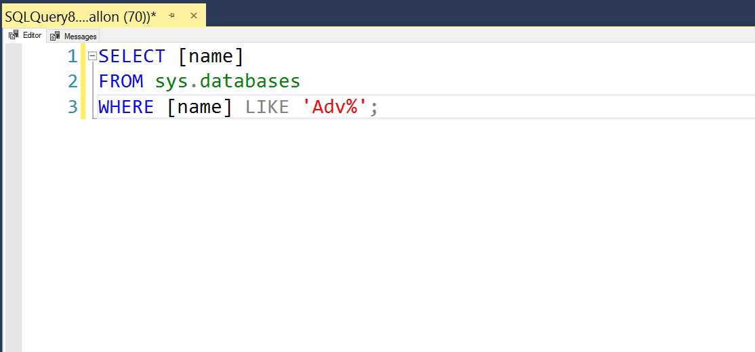
Include query in result set

Slide 37
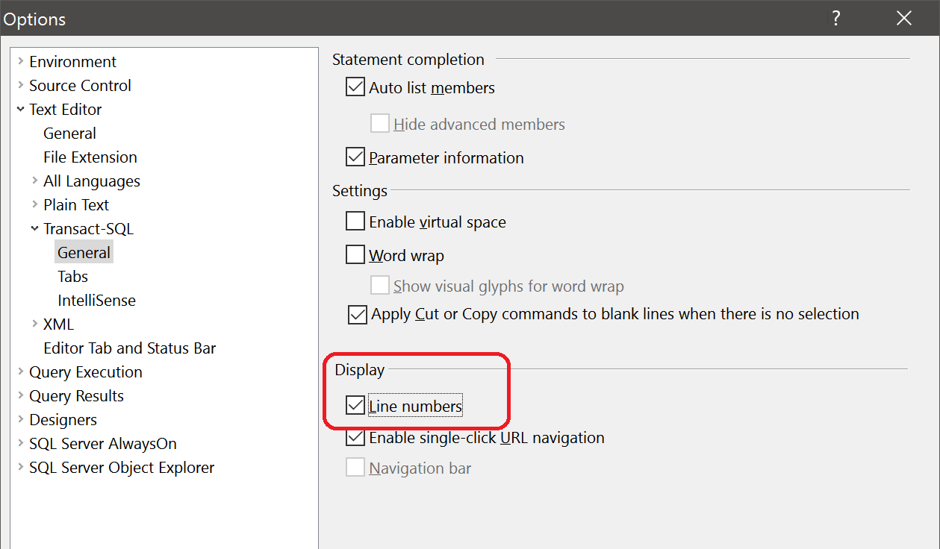
Line numbers in SSMS

Slide 38
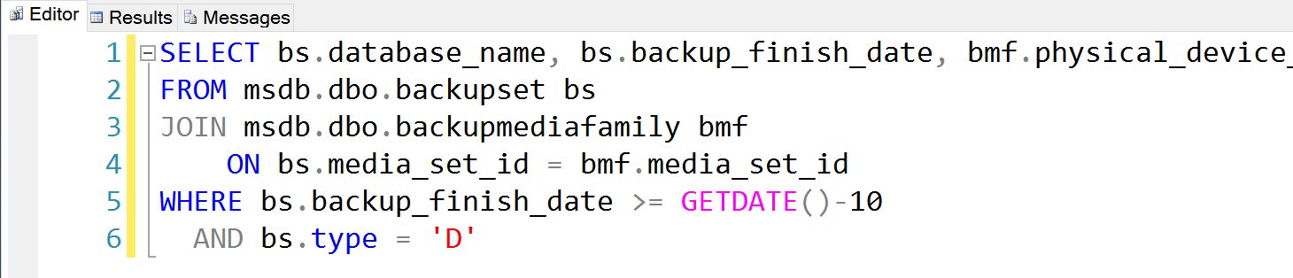
Line numbers in SSMS

Slide 39
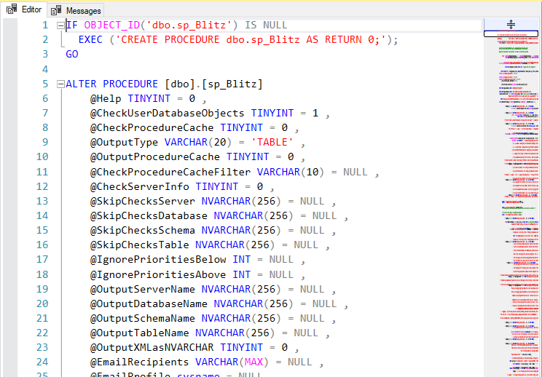
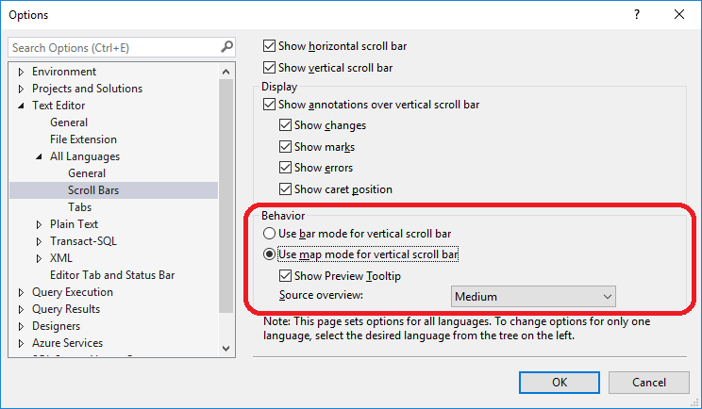
Scroll bar “map mode”

Slide 40
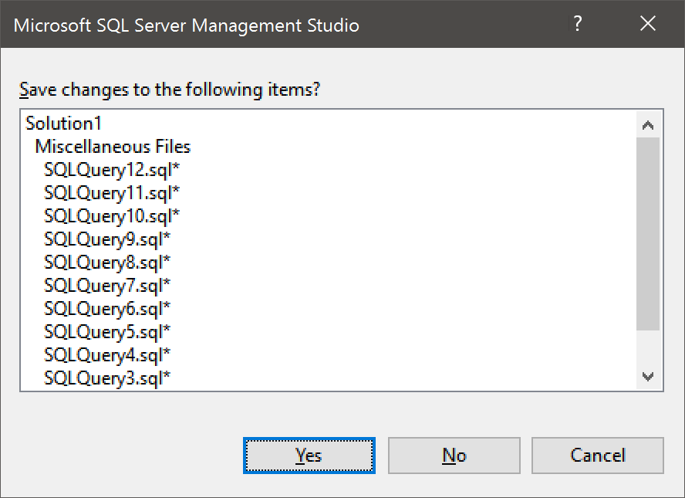
Save changes to the following items?
Notes:
This is what it looks like every time I quit SSMS. About once per year, I actually want to save something

Slide 41
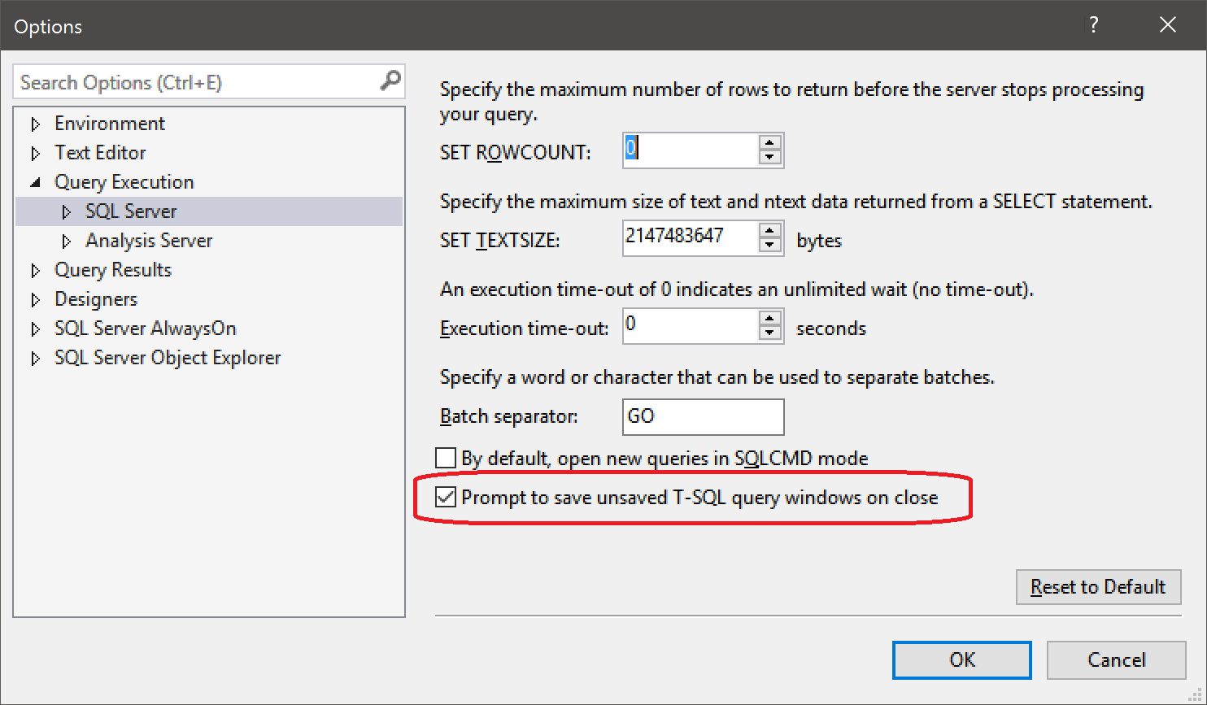
Don’t bother saving
Notes:
New to SQL 2016

Slide 42
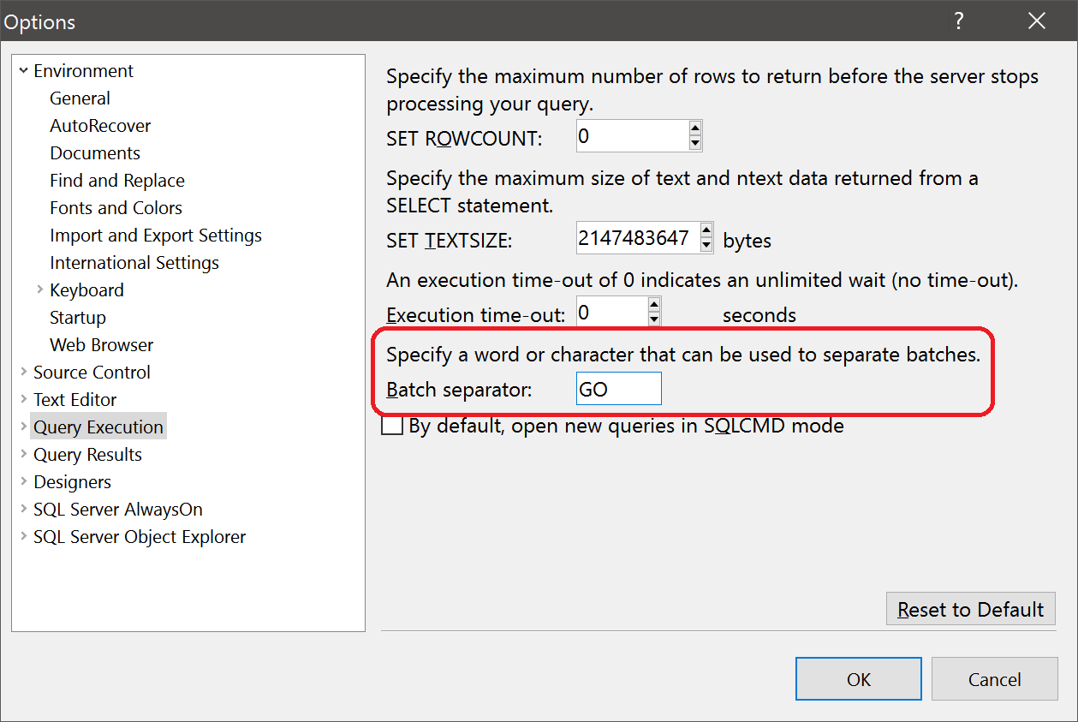
GO
You can change the batch separator in SSMS to be something other than GO
Notes:
OK… so… WHY would you want to do this?

Slide 43
GO have some fun
I can’t think of any reason to do this
Change your coworker’s batch separator to “SELECT”
DO NOT CHANGE YOUR COWORKER’S BATCH SEPARATOR TO “WHERE”
Hilarious with SELECT
Not so funny for DELETE
Notes:
It’s all fun and games until someone tries to DELETE

Slide 44
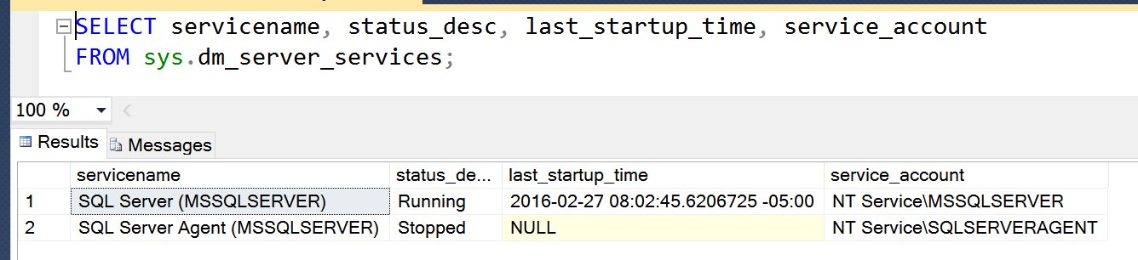
How to find the Service Account
sys.dm_server_services
Introduced in SQL Server 2008R2 SP1
Notes:
Shows all installed SQL Server services, plus startup time.
Will include SSIS, SSAS, SSRS, Full-Text search, etc

Slide 45
What about Azure Data Studio?

Slide 46
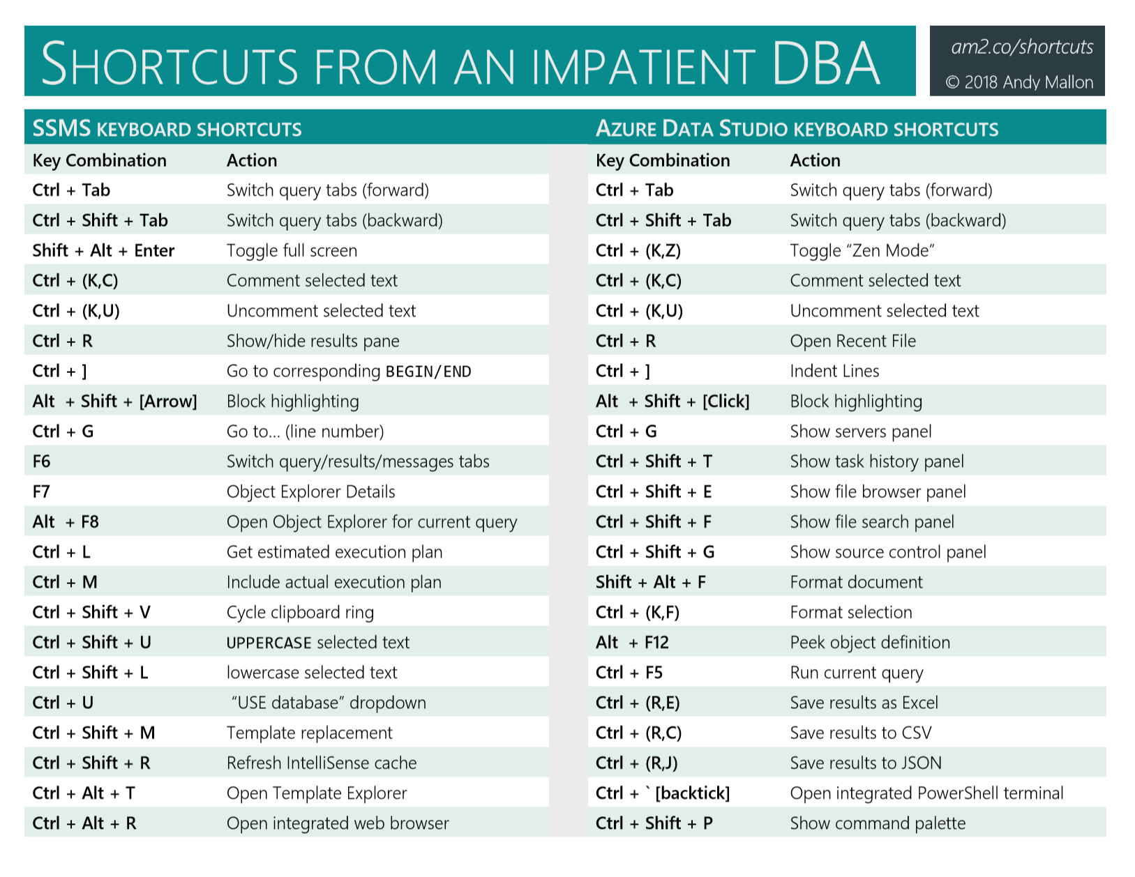
Azure Data Studio shortcuts

Slide 47
Woo hoo! They’re the same!

Slide 48
WTF? All new shortcuts??!!

Slide 49
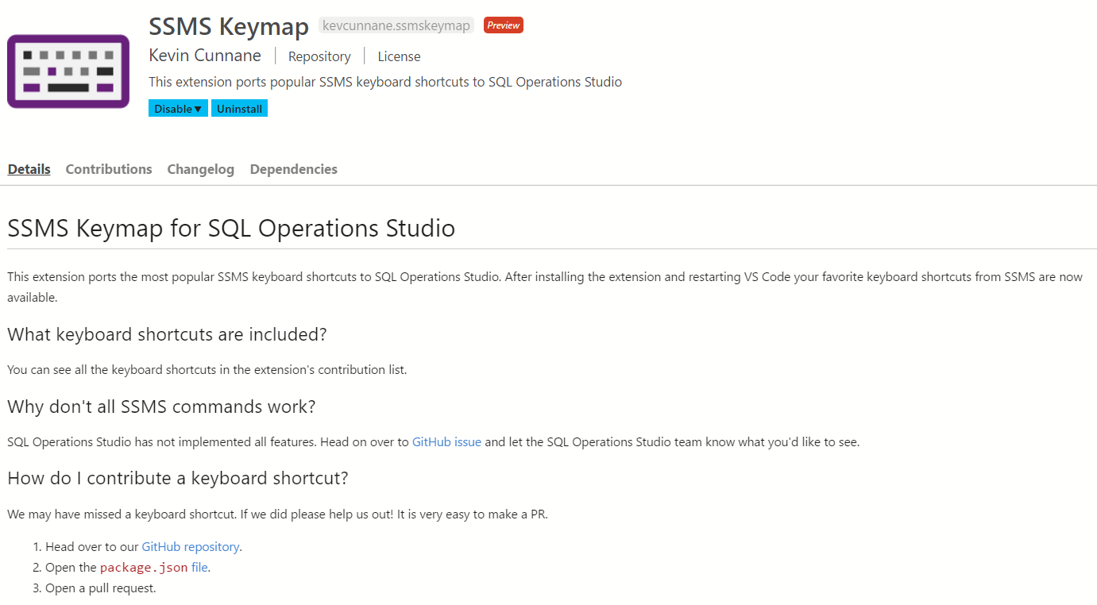
SSMS Keymap
Azure Data Studio extension
by Kevin Cunnane, Engineering Manager, Microsoft
This extension ports the most popular shortcuts to Azure Data Studio

Slide 51
Windows keyboard shortcuts

Slide 52
Windows Shortcuts
Win + R
Win + E
Win + L
Ctrl + Alt + End
Win + X (Windows 8+, 2012/R2)
Ctrl + Scroll wheel (many apps, including SSMS)

Slide 53
Win + [Arrow keys]
Win + UP
Maximize window
Win + Down
Restore (when maximized)
Minimize (when not maximized)
Win + Left/Right
Dock on Left/Right size of current monitor

Slide 54
Virtual Desktops (Windows 10)
Win + CTRL + D
Create virtual desktops
Win + CTRL + LEFT/RIGHT
Switch to next/previous virtual desktop
Win + Tab
“Task view”
Select any desktop or any window on current desktop
Win + CTRL + F4
Close current virtual desktop

Slide 55
Windows shortcuts & tricks

Slide 56

Shortcut to a better Control Panel
Create a folder and name it this:
Admin.{ED7BA470-8E54-465E-825C-99712043E01C}
The “Magic GUID” will create a folder called “Admin” that contains a direct shortcut to every single Control Panel option
Nothing special about the word “Admin”
Flattens all the nested Control Panel pages into a single list
Works on all currently supported versions of Windows
Sorry XP users!
Notes:
AKA “God Mode”
Somehow, I missed that this has been a feature since Windows 7

Slide 57
Shortcut to a better Control Panel
Microsoft publishes a list of “Canonical Names of Control Panel Items”
http://go.am2.co/MagicGuids
This doesn’t work with new-style Windows 10 Settings
Windows Update.{36eef7db-88ad-4e81-ad49-0e313f0c35f8}
This doesn’t work on Windows 10
MPIO.{AB3BE6AA-7561-4838-AB77-ACF8427DF426}
Server OS version only

Slide 58
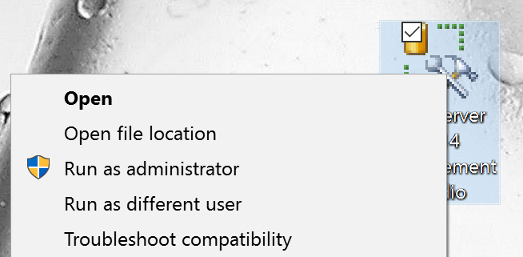
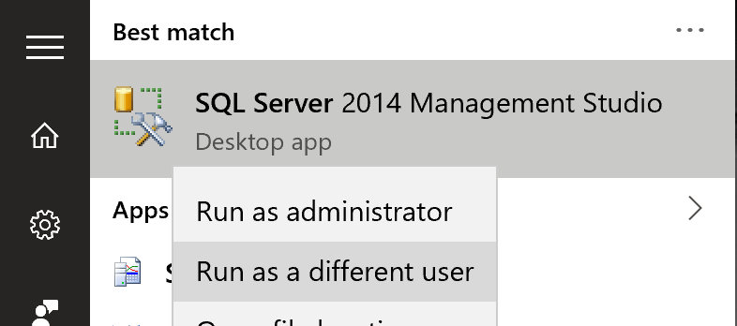
Run as (a) different user
Shift + Right-Click
Right-Click from Win10 Start Menu
Notes:
This is how you can run SSMS as a different user, and use trusted authentication. Multiple domain accounts? Multiple domains? I have two domain accounts at work: “amallon” and “amallon.admin”.
This is also a great example of how consistent Microsoft is in the UI design. Where’s Allan Hirt?

Slide 59
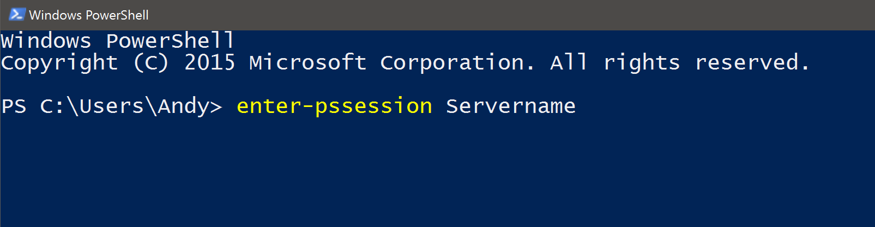
Powershell: Enter-PsSession
Remote Desktop for PowerShell
Starts an interactive session with a remote computer
Notes:
Allows you to interact with another machine from the PowerShell prompt on your machine

Slide 60
Is Lock Pages In Memory enabled?
Whoami /priv
Remember, you need to do this as the service account
EXEC xp_cmdshell 'whoami /priv'
If enabled
If no proxy account

Slide 61
Is Lock Pages In Memory enabled?
Combine three shortcuts:
Run PowerShell prompt as a different user
Shift + Right-Click
Use Enter-PsSession to start a session on the server
Use whoami /priv to get your answer

Slide 62
Is Lock Pages In Memory enabled?
PS C:\> Enter-PsSession ServerName
[ServerName]: PS C:\> whoami /priv
PRIVILEGES INFORMATION
----------------------
Privilege Name State
============================= ========
SeLockMemoryPrivilege Enabled
SeManageVolumePrivilege Enabled
Notes:
There will be a bunch of stuff in the output. Look for “SeLockMemoryPrivilege” … if it’s not there, that means it’s not enabled.
You can also check for “SeManageVolumePrivilege” – “Manage Volume Maintenance Tasks” – The permission necessary for Instant File Initialization (IFI)

Slide 63
Blue Screen on Demand
HKLM\System\CurrentControlSet\Services\ kbdhid\Parameters
Create a value named CrashOnCtrlScroll
Set it equal to a REG_DWORD value of 0x01
Hold right-Control & tap Scroll Lock twice
From David Klee
http://www.davidklee.net/2015/11/30/summon-blue-screens-of-death-for-testing-purposes-only-of-course/

Slide 64
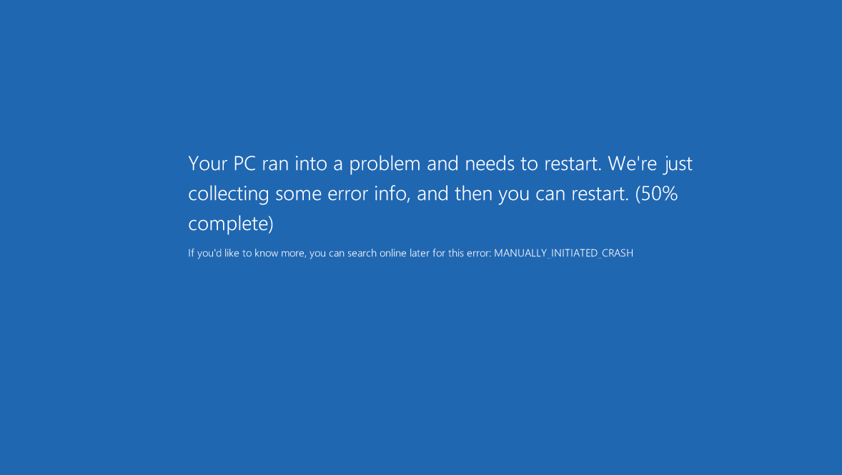

Slide 65
Pause the SQL Server service
Allows connected users to continue work
Prevents new connections
Error: 17142, Severity: 14, State: 0. SQL Server service has been paused. No new connections will be allowed. To resume the service, use SQL Computer Manager or the Services application in Control Panel.
Error: 18456, Severity: 14, State: 13. Login failed for user ''. Reason: SQL Server service is paused. No new connections can be accepted at this time. [CLIENT: <local machine>]
From Tom LaRock
http://thomaslarock.com/2016/01/pause-sql-server-service-before-restarting/
Notes:
You might want to do this before planned maintenance, rather than killing sessions
Useful during an emergency, too…letting user connections bleed off

Slide 66
Your turn!
What are your favorite shortcuts & tricks?
Notes:
Teach me something!

Slide 67

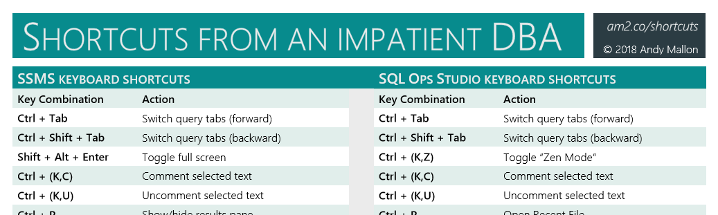
Slides + more
AMtwo.co/shortcuts-ppt

Slide 68
Questions?

Slide 69
Resources
Blog posts about these tips
AMtwo.co/shortcuts
These slides + cheat sheet
AMtwo.co/shortcuts-ppt
SSMS Keymap for SQL Ops Studio
github.com/kevcunnane/ssmskeymap
Additional information referenced in slides
AMtwo.co/RemapSSMS
go.am2.co/MagicGuids
davidklee.net/2015/11/30/summon-blue-screens-of-death-for-testing-purposes-only-of-course/
thomaslarock.com/2016/01/pause-sql-server-service-before-restarting/

